Slide 1
UNION
A union is a user-defined data type that allows you to store different data types in same memory location.
We can define a union by using “UNION” keyword. The union statement defines new data type with more than one member for your program.
Syntax:
union union-name
{
union element-1;
union element-2;
- - -
- - -
union element-n;
}union-variable;

Slide 2
Example:
union data
{
int i;
float f;
char str[20];
}d;
Here union variable d can store an integer, a floating point number or a string. It means a single variable i.e., same memory location can be used to store multiple types of data.
The memory occupied by a union will be the largest member memory of the union. In the above example data d will occupy 20 bytes of memory.

Slide 3
ACCESSING UNION MEMBERS:
If we can access the members of union, first we create union variable then we can access the members of it.
The following syntax is used to create a union variable
By using keyword union we can define union variables.
Syntax:
union union-name variable-name;
To access any member of a union we use the member access operator’.’

Slide 4
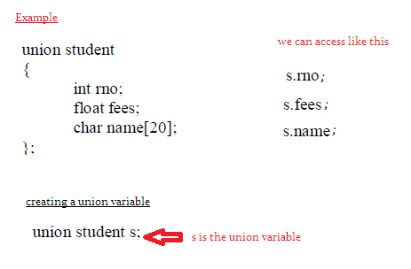

Slide 5
Example
#include<stdio.h>
union sample
{
int a;
float b;
char c;
};
void main()
{
union sample s;
printf(" Enter a value \n");
scanf("%d",&s.a);
printf(" Enter b value \n");
scanf("%f",&s.b);
printf(" Enter any character \n");
getch(s.c);
printf(" a value : %d \n",s.a);
printf(" b value : %f \n",s.b);
printf(" the character is : \n");
putch(s.c);
}

Slide 6
Here we have to remember a few points regarding union
When s.b is assigned a value, automatically s.a ia erased , similarlly when s.c is assigned
a value , automatically s.b value is erased. That means whenever we assigned a value
To the member of union , then the previous value is automatically erased, because
In union at a time one member can access the memory. We can’t access all the members
At a time.

Slide 7
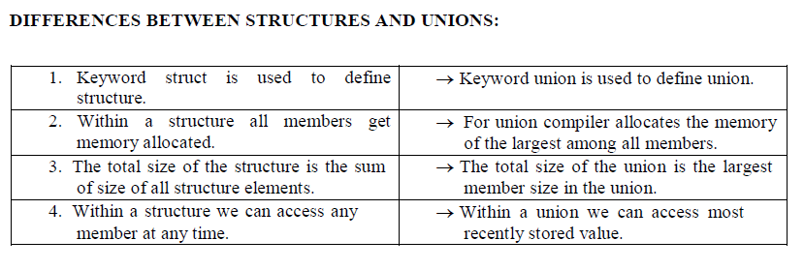

Slide 8
ENUMERATED DATA TYPE:
An enumeration is user-defined data type consist of integer constants and each integer constant given a name.
(or)
Enumeration (or enum) is a user defined data type in C. It is mainly used to assign names to integral constants, the names make a program easy to read and maintain.
keyword “enum” is used to define enumerated datatype.

Slide 9
Syntax:
enum type-name { value-1,value-2, ........... value-n };
Here type-name is the name of enumerated datatype and value-1, value-2 ...... value-n are the values in the enumeration.
By default value-1 will be equal to 0, value-2 will be 1 and so on, the programmer may change the default value also.

Slide 10
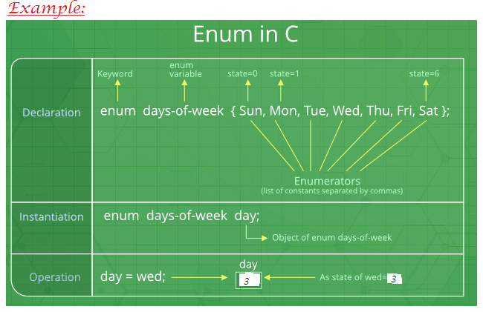

Slide 11
Example:
// An example program to demonstrate working of enum in C
#include<stdio.h>
enum week{Mon, Tue, Wed, Thur, Fri, Sat, Sun};
int main()
{
enum week day;
day = Wed;
printf("%d",day);
return 0;
}
Output:
2

Slide 12
Example:
// Another example program to demonstrate working of enum in C
#include<stdio.h>
enum year{Jan, Feb, Mar, Apr, May, Jun, Jul,
Aug, Sep, Oct, Nov, Dec};
int main()
{
int i;
for (i=Jan; i<=Dec; i++)
printf("%d ", i);
return 0;
}
Output:
0 1 2 3 4 5 6 7 8 9 10 11

Slide 13
Example:
#include <stdio.h>
enum State {Working = 1, Failed = 0, Freezed = 0};
int main()
{
printf("%d, %d, %d", Working, Failed, Freezed);
return 0;
}
Output:
1, 0, 0

Slide 14
Example:
#include <stdio.h>
enum day {sunday = 1, monday, tuesday = 5,
wednesday, thursday = 10, friday, saturday};
int main()
{
printf("%d %d %d %d %d %d %d", sunday, monday, tuesday,
wednesday, thursday, friday, saturday);
return 0;
}
Output:
1 2 5 6 10 11 12

